Slide 1
Vip link
Introduction to Bootstrapping in Data Science — part 1 | by Alejandro Rodríguez | Towards Data Science
https://towardsdatascience.com/introduction-to-bootstrapping-in-data-science-part-1-6e3483636f67
Demystifying hypothesis testing with simple Python examples | by Tirthajyoti Sarkar | Towards Data Science
https://towardsdatascience.com/demystifying-hypothesis-testing-with-simple-python-examples-4997ad3c5294
Central Limit Theorem: a real-life application | by Carolina Bento | Towards Data Science
https://towardsdatascience.com/central-limit-theorem-a-real-life-application-f638657686e1
Notes:
A one-sample bootstrap hypothesis test | Python
https://campus.datacamp.com/courses/statistical-thinking-in-python-part-2/introduction-to-hypothesis-testing?ex=11
Bootstrap statistics — how to work around limitations of simple statistical tests | by Florin Andrei | Towards Data Science
https://towardsdatascience.com/bootstrap-statistics-how-to-work-around-limitations-of-simple-statistical-tests-13180a301efd
Non‐parametric methods for cost‐effectiveness analysis: the central limit theorem and the bootstrap compared - Nixon - 2010 - Health Economics - Wiley Online Library
https://onlinelibrary.wiley.com/doi/abs/10.1002/hec.1477
probability theory - Some case when the central limit theorem fails - Mathematics Stack Exchange
https://math.stackexchange.com/questions/164456/some-case-when-the-central-limit-theorem-fails
<number>

Slide 2

Imp link
Notes:
(1) Real-world application of the Central Limit Theorem (CLT) - YouTube
https://www.youtube.com/watch?v=N7wW1dlmMaE
<number>

Slide 3
To do
Std error vs std dev stat quest in order to understand lesson 10 concept 10
Bootstrap is all about variation( std dev or CI) to understand the two ways of hypothesis testing
Never start with a hypothesis cassie
One sided vs two sided
Cassie article on different p values
P values with puppies
Statistics is boring
1 tailed two tailed stat quest
Tom lecture most common mistake hypothesis testing, 1 point vs interval
Multiple correction two types
Notes:
<number>

Slide 4
Covered in udacity
Notes:
Pupulation sample statistic parameter
Sampling distribution (in details with simulation ) I should use shiny and demystifying
Law of large numbers
CLT
Bootstraping
Statistical vs practical significance
Hypothesis testing
Types of Errors
P value
Sample size detrimental effect on hypothesis testing
<number>

Slide 5
https://projects.datacamp.com/projects/20
Handwashing project in datacamp
Seems really good. Has bootsrapping cI

Slide 6
Consider giving each group a task
DataCamp
https://learn.datacamp.com/projects/184

Slide 7
Agenda
Hypothesis testing
P-valuse
Confidence interval
Classical tests
Central limit theorem
bootstrapping
Mobile game project

Slide 8

What is the purpose ?
انتي جاية اشتغلي ايه؟
04/10/2022
<number>
Notes:
Data
Aim
<number>

Slide 9


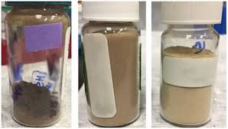
04/10/2022
Source:
<number>
Notes:
Predict or classify
<number>

Slide 10

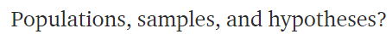
Statistics
Notes:
Most important question in statistics?
<number>

Slide 11

Default action

Slide 12


Notes:
Search for aliens on a planet ur manager is waiting for a report that has only this.
Yes or no
<number>

Slide 13

Notes:
Oxygen almost finised
U won’t be able to discover the whole planet
Uncertainty
What if I didn’t find info, shall I answer with yes or no?
<number>

Slide 14
Default action
Notes:
U can choose any.
In fact it is an MBA question that has to deal with decision maker not with numbers
It is a decision taken while relaxing on a coach
<number>

Slide 15

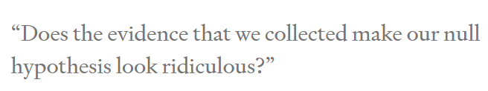
Alternative action
Notes:
If u choose NO as the default action or null hypothesis
Then u won’t choose yes except if data makes pressing no feels ridiculous
<number>

Slide 16
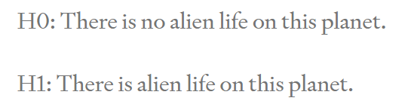

Slide 17


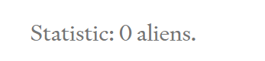
Collect data
Notes:
Thus no aliens on planet
Is it fair ?
U could have missed an alien that u didn’t see
<number>

Slide 18


Statistics
Notes:
Legal contract
We are only interested in population
Anything related to our sample is boring
<number>

Slide 19
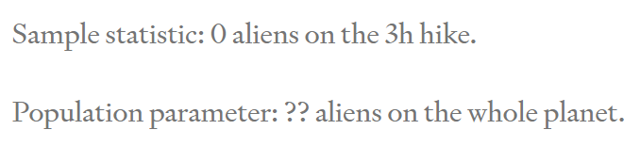
What did we learn?

Slide 20
What did we learn?
Notes:
Analytics can very easily find interesting results as we simply examine the sample only
<number>

Slide 21
Notes:
Medical oncology doctors
Search for a significant p value
<number>

Slide 22
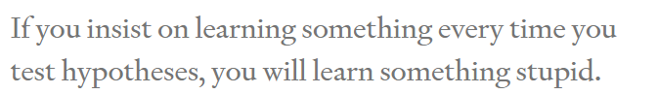

Slide 23
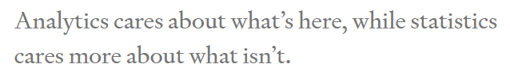

Notes:
Prof tom
The estimate is not the important thing
How confident are u with the estimate
<number>

Slide 24
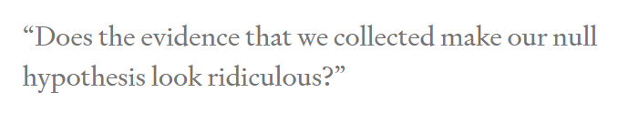
When to change mind?
Notes:
Making decisions based on facts (parameters) is hard enough as it is, but -curses!- sometimes we don’t even have the facts we need. Instead, what we know (our sample) is different from what we wish we knew (our population). That’s what it means to have uncertainty.
<number>

Slide 25

Notes:
Supposing it’s an alien not anything else
Found an alien
<number>

Slide 26
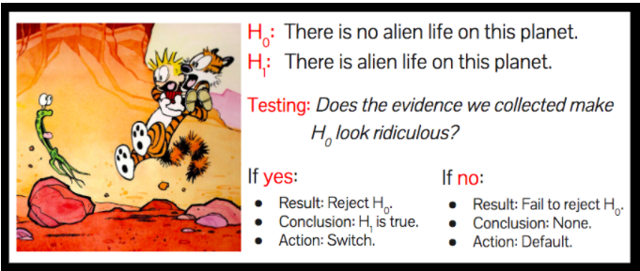
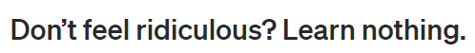
Notes:
<number>

Slide 27
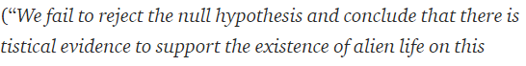


Slide 28


Actions vs learning
Notes:
Tragedy for learning nothing
We were not here to learn. We were here to take actions.
We have taken a sensible action based on data. We choose the wisely selected default action
<number>

Slide 29



Notes:
Why do the stats from the beginning ?
We could have laid down and choose the dafault button
Because u have actually worked hard, in a fairly manner, attempting to change ur mind if u get enough data.
Thus when u choose the default action now, u choose it wenta dameerak merta7
Ma3 enak 3aref en mmken yekoon kararak ghalat (uncertainty) bs this is the best u can do
And that’s why it is always good to increase sample size
To recude type 1 and type 2 errors
<number>

Slide 30
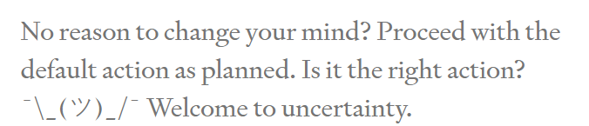

Slide 31



How to measure “ridiculous”?
Confidence interval
P value
Notes:
Is the yelling enough to change ur mind?
The lower the p value
The more yelling at me
Leave the default action
How to measure yelling?
Compare to a preset significance level
This level determines how much risk u tolerate to take
If u set it to zero
U refuse to leave the default action
Don’t do statistics
The definition of a p-value is the probability of observing your statistic (or one more extreme in favor of the alternative) if the null hypothesis is true.
<number>

Slide 32


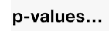
الملتقى
Classical tests( t test/ chi square / ANOVA/ .. )
Central limit theorem
Bootstrapping
Newer tests
Notes:
<number>

Slide 33
Difference between ci and p value?
Coming soon isA..

Slide 34
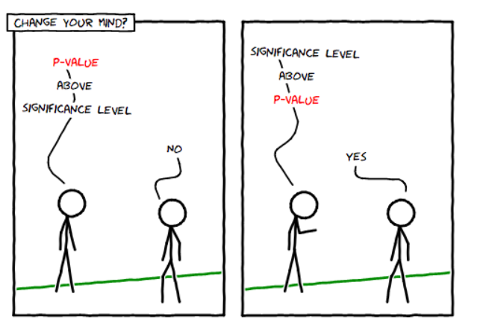

Slide 35
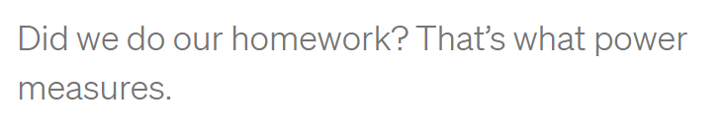

Notes:
3 hours were not enough
What about 30 sec
Easy to stick to default action, but results would be misleading
U didn’t do ur hw
The more u have the more opportunity u have given urself to change ur mind if that’s the right thing to do
<number>

Slide 36


1000000 hours
Notes:
Why not spend 1000000 hours
Balance between money and effort and time and benefit
<number>

Slide 37

Change default action
Pick YES?
Notes:
<number>

Slide 38
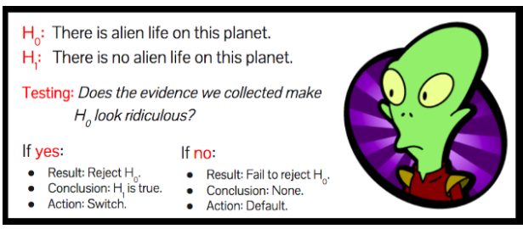

Slide 39
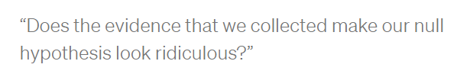
MAIN QUESTION
Notes:
<number>

Slide 40

Default action
!! What to expect??
Notes:
<number>

Slide 41
Answer is No. Always!
Notes:
Suppose we see an alien. Is our null hypothesis ridiculous? No, of course not. How about if we hike for three hours and we see no aliens? Is the null hypothesis of alien life ridiculous? Still no. (If you’re struggling with this, you should really go hiking on planet Earth some time. It’s easy to go three hours without seeing other humans…)
Evidence never make the null hypothesis ridiculous
<number>

Slide 42

2 OPTIONS
OR Every corner
sometimes we can see the answer. .No need to calculate
Notes:
Work from home
Or gather entire population! (that’s not statistics)
<number>

Slide 43
Bottom line!
Start with default action. Choose wisely!
Don’t have default action? No need for statistical inference!

Slide 44
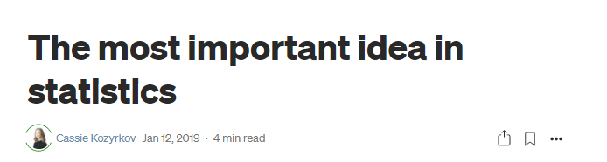
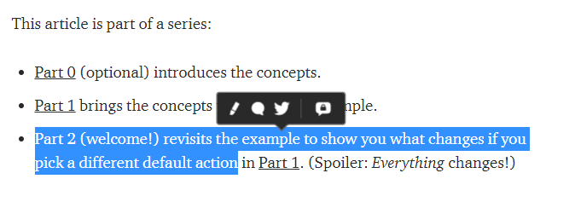
Notes:
The most important idea in statistics | by Cassie Kozyrkov | Towards Data Science
https://towardsdatascience.com/the-most-important-idea-in-statistics-8c18d514ad1c
Statistical inference in one sentence | by Cassie Kozyrkov | HackerNoon.com | Medium
https://medium.com/hackernoon/statistical-inference-in-one-sentence-33a4683a6424
<number>

Slide 45
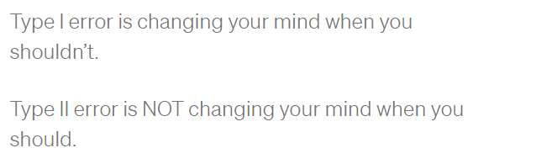
Type I and ii errors

Slide 46
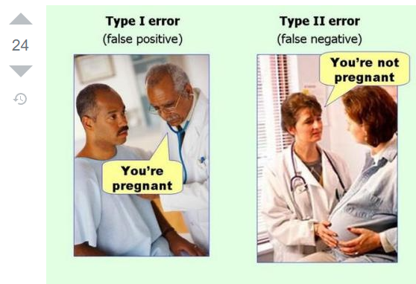
Notes:
Discuss how sample size can keep type 1 error rate
And in the same time decrease type 2 error
<number>

Slide 47

P values
Handwashing project

Slide 48

Setting the scene

Slide 49
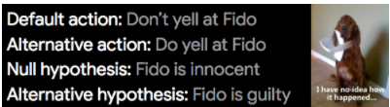

Slide 50
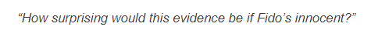
Describe the null world
Answer is pvalue
Notes:
What we’re doing here is visualizing the null hypothesis world and figuring out how things work there so we can make a toy model of it. That’s what the calculations are all about.
<number>

Slide 51

Notes:
<number>

Slide 52

Living alone
Notes:
<number>

Slide 53
conclusion
“If I’m living in my default action world, how surprising is my evidence?”
p-value low enough ➔ change my mind

Slide 54

But which is small enough?
0.06
0.04
0.01
0.00001
Notes:
We need a reference!
<number>

Slide 55
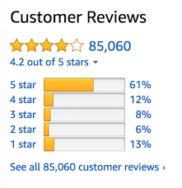
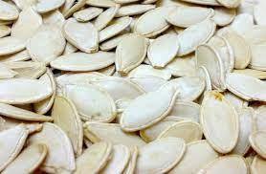
Take the decision for threshold in advance!!

Slide 56
0.05 threshold
5% of times. Wrongly change ur mind FALSE POSITIVE

Slide 57
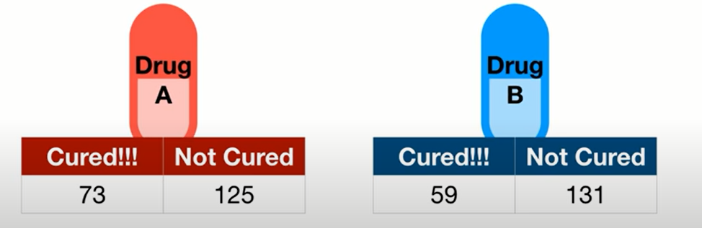
0.05 threshold
What’s the null hypothesis?
5% of times. U will decide they’re different. [while they are not different]
FALSE POSITIVE
Notes:
Null hypothesis: drugs equal
<number>

Slide 58
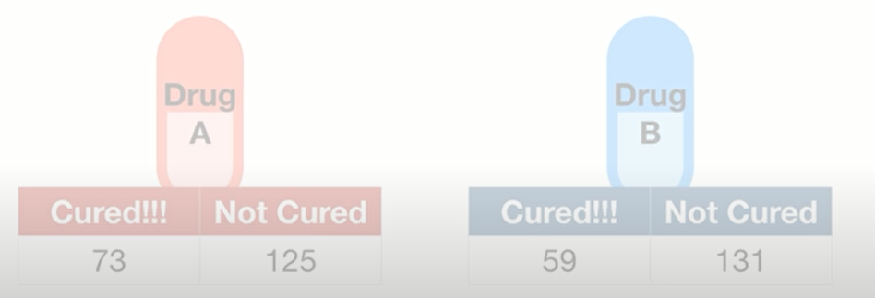
Critical drug!
0.01 threshold
1 False positive every 100 experiments
Notes:
If it’s extremely important to avoid false positive, use a lower threshold
<number>

Slide 59
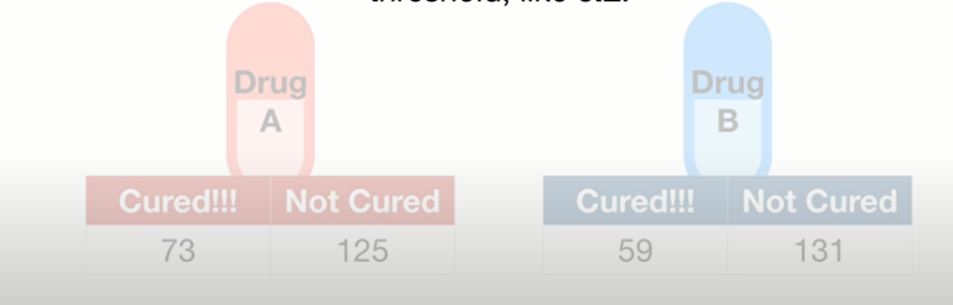
Ice cream arrival on time
0.2 threshold
20 False positive every 100 experiments

Slide 60
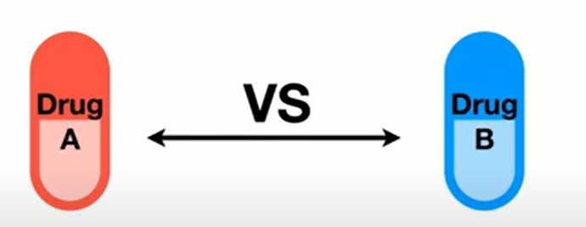
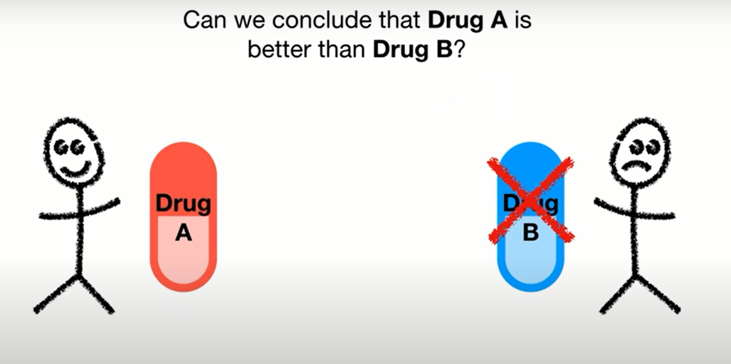
P values
Notes:
I gave each drug to a single person
<number>

Slide 61
P values
1- medication interaction
2- missed a dose
3- allergy
حاسس اني خفيت
Notes:
Drug B may have failed due to
1- medication interaction
2- missed a dose
3- allergy
Drug A may have succeeded due to placebo effect
<number>

Slide 62
P values
1- medication interaction
2- missed a dose
3- allergy
حاسس اني خفيت
Just by chance!
Notes:
Drug B may have failed due to
1- medication interaction
2- missed a dose
3- allergy
Drug A may have succeeded due to placebo effect
<number>

Slide 63
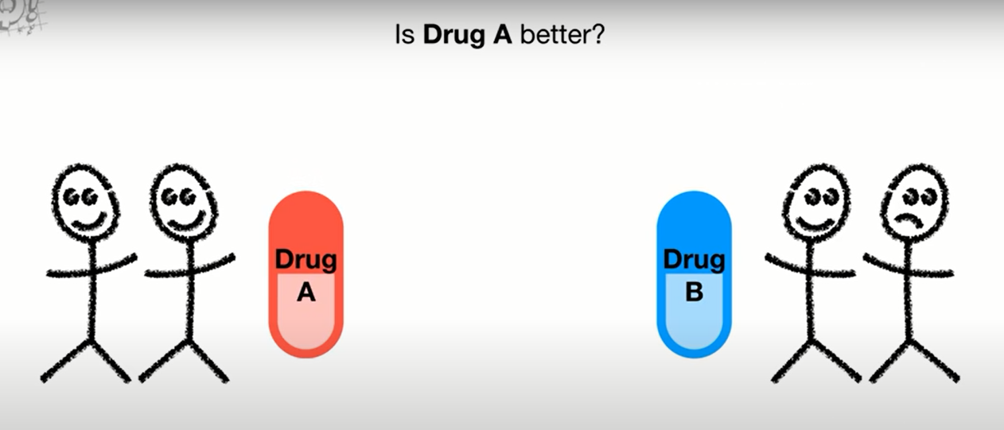
By chance
Notes:
Maybe the first patient in drug B was cured because of placebo
Or the one who failed, because of storage conditions
<number>

Slide 64
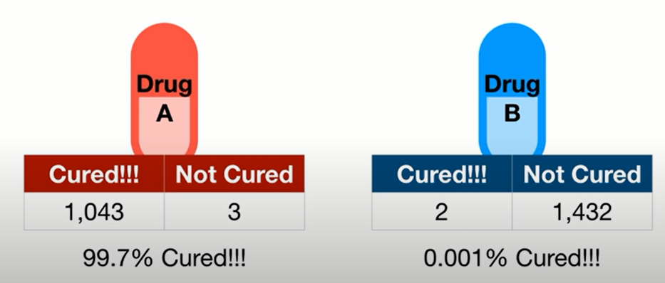
How to decide?
Is it random chance?
Notes:
This feels ridiculous ?
Yes
So it is probably not random chance
<number>

Slide 65
How to decide?
Not cured ➔ missed doses
Cured by psychology
Is it random chance?
Notes:
Maybe some with drug A has been cured, just by placebo (psychology)
Maybe some with drug B were not cured because they missed doses
But with all these numbers, probability that chance has played a major role is minimal
<number>

Slide 66
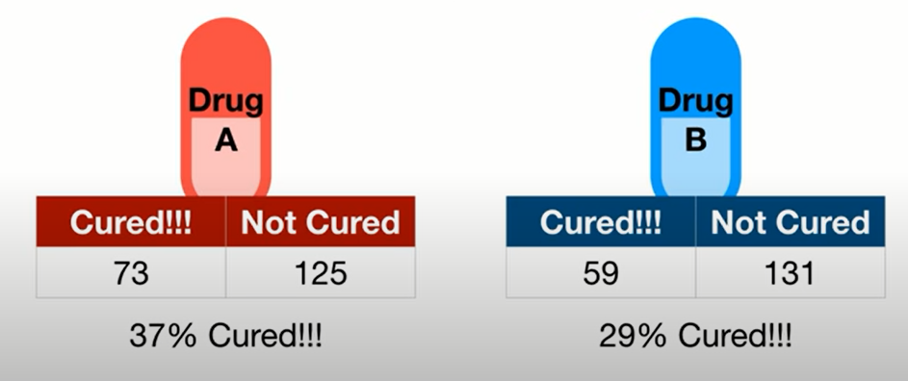
How confident are we?
Random things may happen
Notes:
<number>

Slide 67
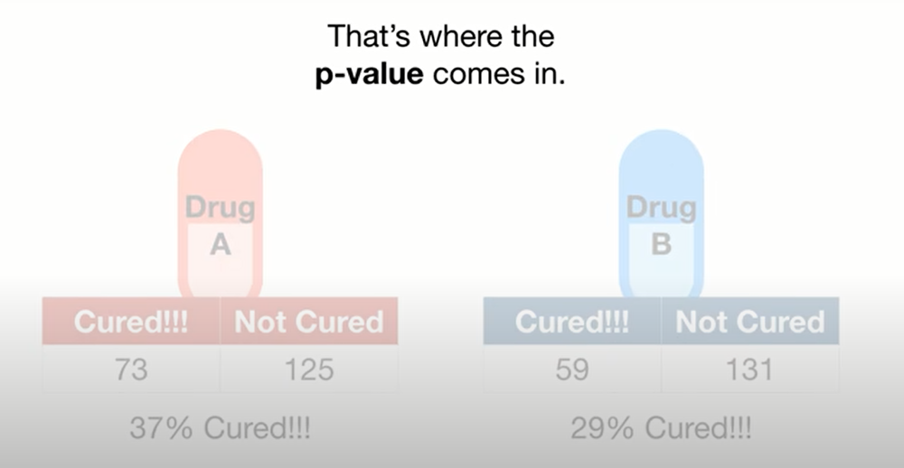

Slide 68
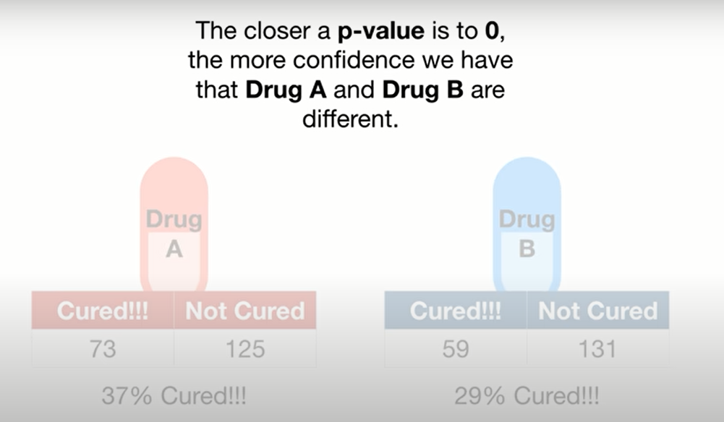
But how small?
Threshold
Notes:
How small p value should be to confident that A is diff than B?
<number>

Slide 69
Default action/ null hypothesis world
Probability that something strange like this happens

Slide 70
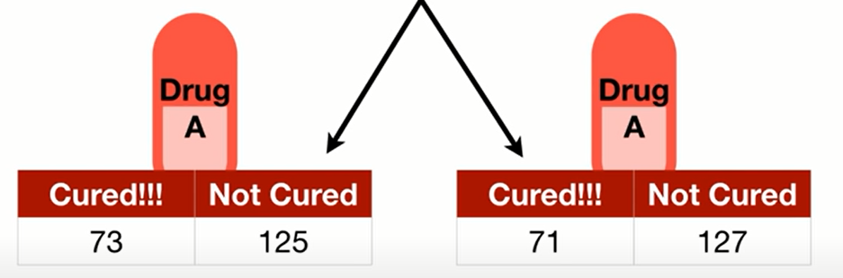
What’s the reason?
Null hypothesis world
Notes:
Differences are solely due to random chance
Either placebo in the cured or allergy in the not cured
<number>

Slide 71
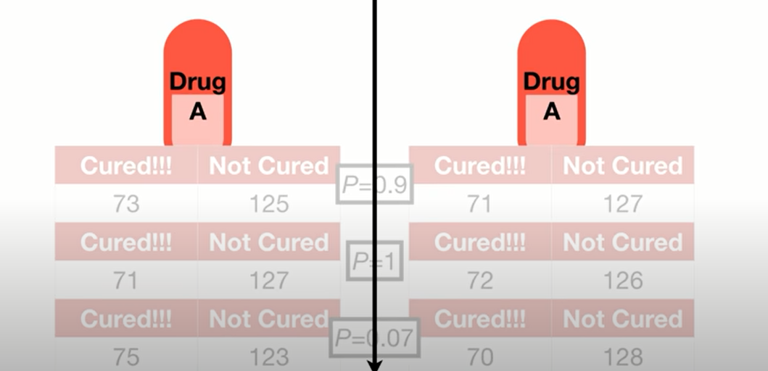
Repeating experiment

Slide 72
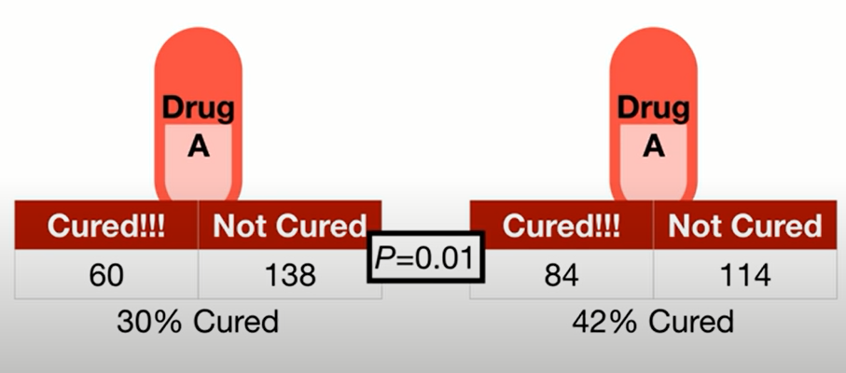
One time… Just by chance
Conclusion : Different groups FALSE POSITIVE
Notes:
Just by chance, something like this would happen
Getting a p value below the threshold when there is no difference is called false positive
<number>

Slide 73
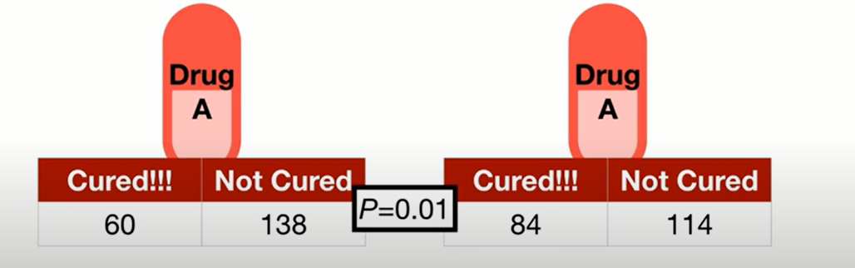
0.05 threshold
5% of times, this would happen just by chance

Slide 74
Difference between groups
5% of times, this would happen just by chance
Notes:
<number>

Slide 75
Critical drug!
0.01 threshold
1 False positive every 100 experiments
Notes:
If it’s extremely important to avoid false positive, use a lower threshold
<number>

Slide 76
Ice cream arrival on time
0.2 threshold
20 False positive every 100 experiments

Slide 77
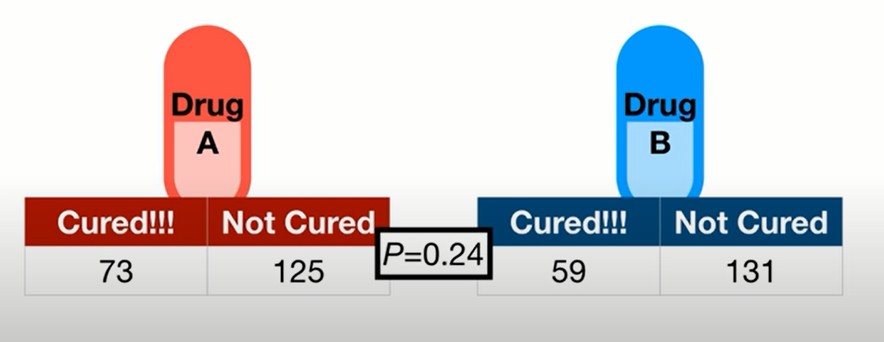
End line
Threshold 0.01
Notes:
Drugs are not different
<number>

Slide 78
Take the decision for threshold!

Slide 79
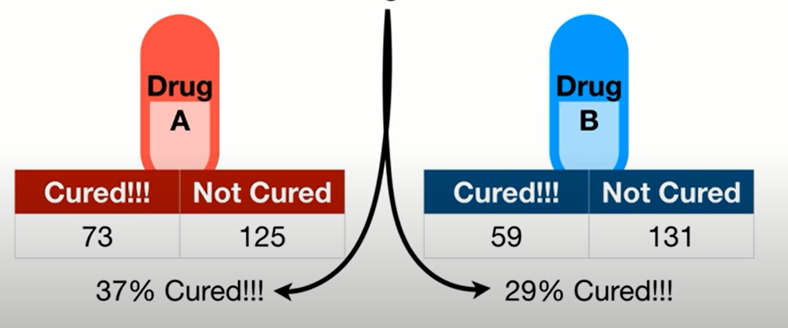
One more tip
8% diff
p = 0.24
Notes:
<number>

Slide 80
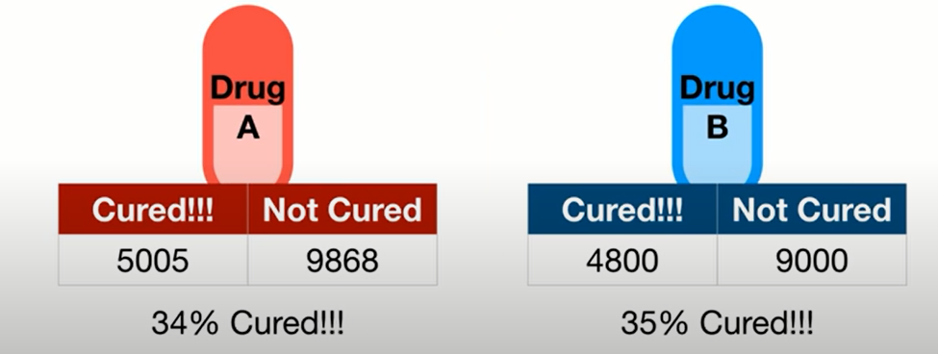
1% diff
p = 0.04
Notes:
<number>

Slide 81
Conclusion
P value is an element of surprise, not a measure of difference.
Notes:
<number>

Slide 82
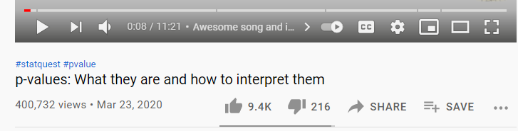
Notes:
p-values: What they are and how to interpret them - YouTube
https://www.youtube.com/watch?v=vemZtEM63GY
<number>

Slide 83
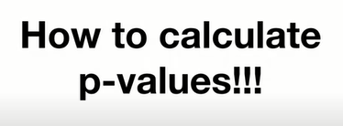

Slide 84
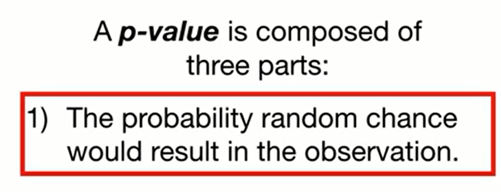
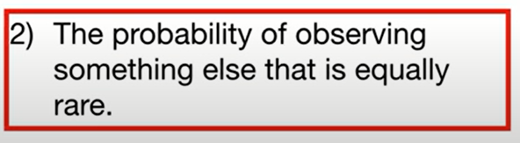
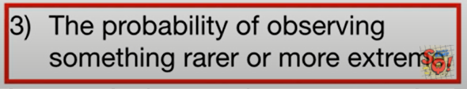
Two sided p value

Slide 85
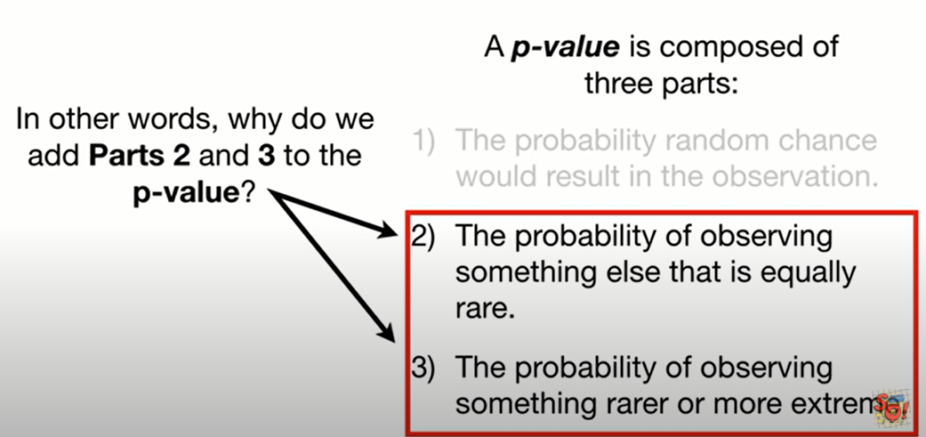

Slide 86

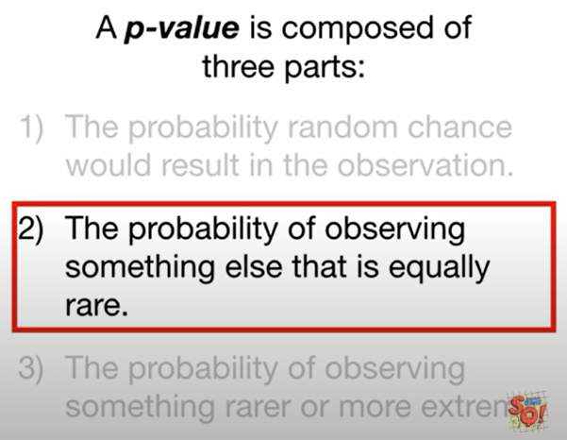

Why add part2?
Notes:
U told ur wife, that’s the rarest flower
She will be surprised
She may give u her jewelery (shabka)
<number>

Slide 87

Why add part2?
Equally as rare
Notes:
She won’t be that surprised. Even if the flowers are different. The event is not rate anymore
<number>

Slide 88


Why add part3?
More flowers are rarer than this flower
Notes:
Again, she won’t be surprised
<number>

Slide 89


experiment

Slide 90

95% CI

Slide 91


Notes:
2.5% at each side
<number>

Slide 92

belong to NULL HYPOTHESIS WORLD?
Notes:
We measure a person height to be 142cm
Does it belong to this distribution that has a mean of 155.7?
<number>

Slide 93

OR ALTERNATIVE HYPOTHESIS WORLD?

Slide 94


Slide 95

Doing a better job
Notes:
<number>

Slide 96

Calculate p value under the null
Which areas should we highlight?
Notes:
<number>

Slide 97

remember

Slide 98

Then compare to a preset threshold

Slide 99

What if we measured someone here?

Slide 101


More extreme

Slide 102


Slide 103

One sided p value

Slide 104

Super drug
Where are more extreme values?
Notes:
We want to test if superdrug help people recover in a short time
We gave the drug to a bunch of people and the results are the red line
<number>

Slide 105



Choose direction
Notes:
<number>

Slide 106


Slide 107


Slide 108

More info?
Notes:
How to calculate p-values - YouTube
https://www.youtube.com/watch?v=JQc3yx0-Q9E
<number>

Slide 109



One sided
What if I want two sided?
Notes:
Imp conclusion
Simulate the values of your statistic that are possible from the null.
Calculate the value of the statistic you actually obtained in your data.
Compare your statistic to the values from the null.
Calculate the proportion of null values that are considered extreme based on your alternative.
<number>

Slide 110


Why??
Notes:
Why did we get the high in this way?
<number>

Slide 111
P values Pitfalls?
0.051 ??
Sample size?
P hacking?

Slide 112


P hacking
Notes:
p-hacking, or cheating on a p-value | Freakonometrics
https://freakonometrics.hypotheses.org/19817
<number>

Slide 113

Confidence interval

Slide 114
Confidence intervals
Many ways to calculate them
We will use the one with bootstrap

Slide 115



Notes:
Some samples included more than once
Others weren’t included
<number>

Slide 116


Repeat previous steps
What about 99%
confidence interval?
Notes:
Same but covers 99% of the means
<number>

Slide 117


Slide 118

Solution
Outside CI
i.e. significant

Slide 119

More info?
Notes:
StatQuest: Confidence Intervals - YouTube
https://www.youtube.com/watch?v=TqOeMYtOc1w
<number>

Slide 120

Any advantages?
Notes:
While the P-value interpretations only differ between results with P < 0.05 and P > 0.05, the confidence interval approach offers five different interpretations, (1) statistically significant and important difference, (2) statistically significant difference which may be important, (3) not statistically significant though A may be better by an important amount, (4) not statistically significant and if there is a difference it is not important, and (5) inconclusive, as an important difference (in both directions) is possible.
Considerations for the design, analysis and presentation of in vivo studies - ScienceDirect
https://www.sciencedirect.com/science/article/pii/S1063458416301911#fig1
<number>

Slide 121
Any advantages?
Direction
Size
significance
Error
Notes:
While the P-value interpretations only differ between results with P < 0.05 and P > 0.05, the confidence interval approach offers five different interpretations, (1) statistically significant and important difference, (2) statistically significant difference which may be important, (3) not statistically significant though A may be better by an important amount, (4) not statistically significant and if there is a difference it is not important, and (5) inconclusive, as an important difference (in both directions) is possible.
Considerations for the design, analysis and presentation of in vivo studies - ScienceDirect
https://www.sciencedirect.com/science/article/pii/S1063458416301911#fig1
<number>

Slide 122

Difference

Slide 123

ratio

Slide 124

p value vs confidence interval
p = 0.049
Notes:
<number>

Slide 125
P value vs confidence interval
Direction
Size
significance
p = 0.049
Notes:
<number>

Slide 126

Practical significance

Slide 127

reporting

Slide 128

Notes:
Confidence interval or p-value?: part 4 of a series on evaluation of scientific publications - PubMed
https://pubmed.ncbi.nlm.nih.gov/19547734/
<number>

Slide 129
Statistical workflow
how to handle statistical problems?
Good, bad, ugly, better??
Notes:
There is no single method.
No method would say no. It just spits out answers. Thus, decisions are taken
What’s the worst and what’s the best?
<number>

Slide 130
question
Best drug for weight loss?
1 OR 2 OR 3

Slide 131

Notes:
which_test_flowchart.png (6131×2669)
https://onishlab.colostate.edu/wp-content/uploads/2019/07/which_test_flowchart.png
<number>

Slide 132

P value parametric: 0.04
P value non par. : 0.63
Notes:
Look at mean and median for both males and female
Look how females are right skewed
GraphPad Prism 9 Statistics Guide - The Mann-Whitney test doesn't really compare medians
https://www.graphpad.com/guides/prism/latest/statistics/stat_nonparametric_tests_dont_compa.htm
<number>

Slide 133
How to check normality?
Notes:
which_test_flowchart.png (6131×2669)
https://onishlab.colostate.edu/wp-content/uploads/2019/07/which_test_flowchart.png
<number>

Slide 134



Normality tests

Slide 135


Notes:
Law of large numbers: the larger the sample size, the closest ur sample statistics to the population parameter
The Central Limit Theorem states that with a large enough sample size the sampling distribution of the mean will be normally distributed.
The Central Limit Theorem actually applies for these well known statistics:
Sample means (\bar{x}x¯)
Sample proportions (pp)
Difference in sample means (\bar{x}_1 - \bar{x}_2x¯1​−x¯2​)
Difference in sample proportions (p_1 - p_2p1​−p2​)
And it applies for additional statistics, but it doesn't apply for all statistics! . You will see more on this towards the end of this lesson.
<number>

Slide 136
Notes:
Law of large numbers: the larger the sample size, the closest ur sample statistics to the population parameter
The Central Limit Theorem states that with a large enough sample size the sampling distribution of the mean will be normally distributed.
The Central Limit Theorem actually applies for these well known statistics:
Sample means (\bar{x}x¯)
Sample proportions (pp)
Difference in sample means (\bar{x}_1 - \bar{x}_2x¯1​−x¯2​)
Difference in sample proportions (p_1 - p_2p1​−p2​)
And it applies for additional statistics, but it doesn't apply for all statistics! . You will see more on this towards the end of this lesson.
<number>

Slide 137
How to check normality?
Notes:
which_test_flowchart.png (6131×2669)
https://onishlab.colostate.edu/wp-content/uploads/2019/07/which_test_flowchart.png
<number>

Slide 138


Notes:
Sample variances are actually known to follow a different type of mathematical distribution known as a chi-squared distribution. Which is a more right-skewed distribution than a normal.
<number>

Slide 139

Do not rely on CLT
Notes:
In the next concepts, you will see that the with large sample sizes the sampling distribution of certain statistics will never become normally distributed. So how do we know which statistics will follow normal distributions, and which will not?
So, you might be wondering already why is the Central Limit Theorem such a big deal? In our new age of computers, it probably isn't as big of a deal, but more on this coming up soon!
Instead of relying on CLT, we can use bootstrapping
<number>

Slide 140
Sampling distribution
A sampling distribution is the distribution of a statistic
Notes:
Second, we found out some interesting ideas about sampling distributions that will be iterated later in this lesson as well. We found that for proportions (and also means, as proportions are just the mean of 1 and 0 values), the following characteristics hold.
The sampling distribution is centered on the original parameter value.
The sampling distribution decreases its variance depending on the sample size used. Specifically, the variance of the sampling distribution is equal to the variance of the original data divided by the sample size used. This is always true for the variance of a sample mean!
In notation, we say if we have a random variable, \bold{X}X, with variance of \bold{\sigma^2}σ2, then the distribution of \bold{\bar{X}}X¯ (the sampling distribution of the sample mean) has a variance of \bold{\frac{\sigma^2}{n}}nσ2​
<number>

Slide 141

Lesson 10 concept 9 (why??) isn’t this a binomial trial? Why did we use the rule for Bernoulli?
Because these are the rules for sampling distribution not binomial
Notes:
https://classroom.udacity.com/nanodegrees/nd002-mena-nfp3/parts/4a2ab02d-3ad9-435a-bdac-ecc06b9208aa/modules/7f5081ca-b9e5-4662-babc-b2a30e4dc31a/lessons/4757541f-77eb-4df6-9ebf-9485a3383dd3/concepts/a56b02a8-f3fb-4e26-a6cb-181202b7d86b
<number>

Slide 142


Notes:
As you saw in this video, we commonly use Greek symbols as parameters and lowercase letters as the corresponding statistics. Sometimes in the literature, you might also see the same Greek symbols with a "hat" to represent that this is an estimate of the corresponding parameter.
<number>

Slide 143

Udacity covered it very briefly
Get cassie video youtube that in 99%+ of cases, ur best guess is the best option
I need to read more.
Notes:
Three of the most common ways are with the following estimation techniques:
Maximum Likelihood Estimation
[Method of Moments Estimation][https://en.wikipedia.org/wiki/Method_of_moments]
Bayesian Estimation
Though these are beyond the scope of what is covered in this course, these are techniques that should be well understood for Data Scientist's that may need to understand how to estimate some value that isn't as common as a mean or variance. Using one of these methods to determine a "best estimate", would be a necessity.
<number>

Slide 144


bootstrapping
Notes:
bootstrap - Explaining to laypeople why bootstrapping works - Cross Validated
https://stats.stackexchange.com/questions/26088/explaining-to-laypeople-why-bootstrapping-works
The question asks, "if we are resampling from our sample, how is it that we are learning something about the population rather than only about the sample?" Resampling is not done to provide an estimate of the population distribution--we take our sample itself as a model of the population. Rather, resampling is done to provide an estimate of the sampling distribution of the sample statistic in question.
Using random.choice in python actually samples with replacement
<number>

Slide 145

Notes:
Learning the central limit theorem and bootstrapping: a hands on approach. | by MB | Analytics Vidhya | Medium
https://medium.com/analytics-vidhya/learning-the-central-limit-theorem-and-bootstrapping-a-hands-on-approach-78da7cad0438
The intro is really nice. Then suddenly it talked about t test in a relatively bad way
<number>

Slide 146

Normal distribution

Slide 147

Central limit theorem in medicine
How to know if someone has a fever?
Temperature falls outside 2 standard
deviations from population mean
Notes:
How important is this theorem to medicine? Well, every biophysical variable we consider for a patient (vitals, labs, ECG, etc.) is defined as normal or abnormal based on this theorem.
In general, someone is said to be afebrile if their core temperature falls within 2 standard deviations of the mean core temperature of the population. Do we know the true mean temperature of the entire human population? Of course not. So how do we know the population mean and standard deviation? Well we have to assume that means and variance of samples within the population follow a normal distribution based on the Central Limit Theorem and then we can use basic statistics to define normal. As an aside, what is normal for core temperature? 37 C right? Not exactly, read more here…
<number>

Slide 148


Fake data

Slide 149


Specific population
Old patients with diabetes

Slide 150

No difference
Are u sure?
Notes:
<number>

Slide 151
bootstrapping
Get the variation
Notes:
bootstrap - Explaining to laypeople why bootstrapping works - Cross Validated
https://stats.stackexchange.com/questions/26088/explaining-to-laypeople-why-bootstrapping-works
The question asks, "if we are resampling from our sample, how is it that we are learning something about the population rather than only about the sample?" Resampling is not done to provide an estimate of the population distribution--we take our sample itself as a model of the population. Rather, resampling is done to provide an estimate of the sampling distribution of the sample statistic in question.
Using random.choice in python actually samples with replacement
<number>

Slide 152
Get the repo
It has some nice code
https://github.com/p-easter/Medium_CLT/blob/d1304df24af06ffab8c44b25926b1ecd5d452f16/README.md

Slide 153
Examine the repo itself. I think it would be great.
Notes:
Lets make some fake data with a normal distribution to answer a clinical question. Lets say we have a population and we would like to know the populations average systolic blood pressure (SBP). Lets make the population a total of 100,000 people. Lets also assume that everyone has an SBP between 70:180 with a mean of 120 and a SD of 13. Here is a look at our data.
<number>

Slide 154


Bootstrapping instead of t-test
T-test – Python for Data Science
https://pythonfordatascienceorg.wordpress.com/independent-t-test-python/
Notes:
Tests for testing assumptions
Plots
Contradicting tests
<number>

Slide 155
No longer needed!

Slide 156
decisions
How to make decisions with t test?
How to make decisions with bootstrap?
How to make decisions when I use central limit theorem?

Slide 157
الملتقى
Classical tests( t test/ chi square / ANOVA/ .. )
Central limit theorem
Bootstrapping
Newer tests
Notes:
<number>

Slide 158
Confidence interval
What about 99%
confidence interval?
Notes:
Same but covers 99% of the means
<number>

Slide 159
Solution
Outside CI
i.e. significant

Slide 160

P value with bootstrapping

Slide 161
Different types of bootstrapping
parametric
Semi parametric
Non parametric
Pros and cons
Notes:
<number>

Slide 162




Bottom line
bootstrap
std
Notes:
<number>

Slide 163

belong to NULL HYPOTHESIS WORLD?
Notes:
We measure a person height to be 142cm
Does it belong to this distribution that has a mean of 155.7?
<number>

Slide 164

OR ALTERNATIVE HYPOTHESIS WORLD?

Slide 165


Easier way?
Notes:
bootstrapped · PyPI
https://pypi.org/project/bootstrapped/
<number>

Slide 166
LIMITATIONS
Notes:
Definition: It assumes that sampling with replacement from the original sample of size n mimics taking a sample of size n from a larger population.
It also has many variants such as the m out of n bootstrap which re-samples m time from a sample of size n where m < n. The nice properties of the bootstrap depend on asymptotic theory.
Limitation: bootstrap does not contain more information about the population than what is given in the original sample. For that reason it sometimes doesn't work well in small samples.
situations where the bootstrap can fail.
1- distributions that do not have finite moments
2- small sample sizes
3- estimating extreme values from the distribution
4- estimating variance in survey sampling where the population size is N and a large sample n is taken.
In some cases variants of the bootstrap can work better than the original approach. This happens with the m out of n bootstrap in some applications In the case of estimating error rates in discriminant analysis, the 632 bootstrap is an improvement over other methods including other bootstrap methods..
A reason for using it is that sometimes you can't rely on parametric assumptions and in some situations the bootstrap works better than other non-parametric methods. It can be applied to a wide variety of problems including nonlinear regression, classification, confidence interval estimation, bias estimation, adjustment of p-values and time series analysis to name a few.
variance - Pros and cons of bootstrapping - Cross Validated
https://stats.stackexchange.com/questions/280725/pros-and-cons-of-bootstrapping
<number>

Slide 167

Notes:
The confidence interval width as the difference between your upper and lower bounds of your confidence interval.
The margin of error is half the confidence interval width, and the value that you add and subtract from your sample estimate to achieve your confidence interval final results.
Ex: 25 +/- 2 %
<number>

Slide 168

Notes:
Can we say the first choice with credible intervals? Or it’s only with machine learning?
<number>

Slide 169


Slide 170
CI vs Machine learning
CI = aggregate values about the population
Machine learning : individual level prediction
How can this be true in linear regression (stats)?

Slide 171

Notes:
Why the other two aren’t correct?
I know that we can’t make individual decisions
But aren’t they both mean the same thing
If I can guess on the pop average, then I can guess on an individual
<number>

Slide 172


Slide 173


Slide 174


Slide 175

Notes:
You are always performing hypothesis tests on population parameters, never on statistics. Statistics are values that you already have from the data, so it does not make sense to perform hypothesis tests on these values.
<number>

Slide 176

Notes:
I SHOULD MENTION how for example in the paired t-test, bootstrapping can be really useful instead of trying to focus on assumptions
<number>

Slide 177
2 ways to test hypothesis
1- confidence int. for ur bootstrap sample and check whether the hypothesized mean lie
2- simulate normal distribution, or any other suitable distribution at the point of Null hypothesis (and compare ur bootstrap sample mean to this population )
Lesson 12 concept 16
Notes:
The question is
The first method is percentile bootstrap
Is the second parametric bootstrap? Or normal bootstrap? Why do we need it anyway?
Also if I am using the normal distribution assumption, why do I need bootstrap? Why didn’t I use t test?
<number>

Slide 178

Correcting error in videos
Lesson 12 concept 17
Notes:
<number>

Slide 179
Std dev of the diff
Notes:
Nice job! That's right. Notice the standard deviation with the difference in means is larger than either of the individual. It turns out that this value for the standard deviation of the difference is actually the square root of the sum of the variance of each of the individual sampling distributions. And the mean has a standard deviation of the original draws divided by the square root of the sample size taken. More on this here and here.
<number>

Slide 180

Notes:
The problem here is the null hypothesis is supported by the data. Thus, it’s analytics as per cassie
No need for mathematics
That;’s why the prob is 1
<number>

Slide 181

Same mystery different code!
Lesson 12 concept 33

Slide 182

Msh fahem
Notes:
Msh fahem awel egaba
I think it is why we took std from our data to provide it to std argument in np.normal
But why is this true? Need to check
<number>

Slide 183



Hypothesis testing without
ping
Notes:
<number>

Slide 184


Slide 185


Slide 186

Effect of sample size
Notes:
Machine learning kicks in, with high sample sizes
<number>

Slide 187


Slide 188

Describe the case of abeer even the journal suggested close to signoificance mention the paper

Slide 189
Breaking the curse of small datasets in Machine Learning: Part 1 | by Jyoti Prakash Maheswari | Towards Data Science
https://towardsdatascience.com/breaking-the-curse-of-small-datasets-in-machine-learning-part-1-36f28b0c044d

Slide 190

Notes:
Get the conversation with Thomas and call
Avoid family wise error rates
Stick with
Fdr
Almost always used in genetics
<number>

Slide 191

Notes:
humor - What is your favorite "data analysis" cartoon? - Cross Validated
https://stats.stackexchange.com/questions/423/what-is-your-favorite-data-analysis-cartoon/38295#38295
<number>

Slide 192

Check links
Notes:
Use the 16 review articles to pinpoint the difference between p values and CI
https://www.youtube.com/watch?v=z98xODInLCQ
https://www.youtube.com/watch?v=tTgouKMz-eI
<number>

Slide 193
What is a p-value
https://rebeccaebarnes.github.io/2018/05/01/what-is-a-p-value

Slide 194
Shiny app CLT

Slide 195

Notes:
The Central Limit Theorem and its misuse
https://lambdaclass.com/data_etudes/central_limit_theorem_misuse/
<number>

Slide 196

Notes:
Six sigma events
https://www.johndcook.com/blog/2018/05/31/six-sigma-events/
<number>

Slide 197

Notes:
Cromwell's rule in Bayesian statistics
https://www.johndcook.com/blog/2008/01/12/musicians-drunks-and-oliver-cromwell/
Very light comparison between frequentist and Bayesian
<number>

Slide 198

Why mean and variance?
Notes:
The short answer is that the mean and variance functions are more convenient for performing various mathematical tricks.
<number>

Slide 199

Notes:
The Central Limit Theorem (CLT) says that if you’re working with lots of data, you can safely assume that the distribution of the sample average is normal (bell-shaped), just like this plushy. In a future article, I’ll tell you all about the CLT and the terrible price of convenient calculations, but I’ll stop here for now to let you digest the barrage of information you so patiently absorbed. Image:
Cassie kozyrgov
<number>

Slide 200


Slide 201

More info?
Notes:
A field guide to the most popular parameters | by Cassie Kozyrkov | Mar, 2021 | Towards Data Science
https://towardsdatascience.com/a-field-guide-to-the-most-popular-parameters-d734596c3f26
<number>

Slide 202

Notes:
One reason the normal distribution is important is that many psychological and educational variables are distributed approximately normally. Measures of reading ability, introversion, job satisfaction, and memory are among the many psychological variables approximately normally distributed. Although the distributions are only approximately normal, they are usually quite close. A second reason the normal distribution is so important is that it is easy for mathematical statisticians to work with. This means that many kinds of statistical tests can be derived for normal distributions. Almost all statistical tests discussed in this text assume normal distributions. Fortunately, these tests work very well even if the distribution is only approximately normally distributed. Some tests work well even with very wide deviations from normality. Finally, if the mean and standard deviation of a normal distribution are known, it is easy to convert back and forth from raw scores to percentiles.
Normal Distribution
https://www.me.psu.edu/casestudy/Statistics/normal.htm
<number>

Slide 203

Notes:
Problems with Using the Normal Distribution – and Ways to Improve Quality and Efficiency of Data Analysis
https://journals.plos.org/plosone/article?id=10.1371/journal.pone.0021403
<number>

Slide 204

Insulin concentration
Notes:
It can’t be negative in 95% confidence intervals
<number>

Slide 205

Recommendations

Slide 206

Notes:
Central Limit Theorem — Misconceptions | by Mate Pocs | Analytics Vidhya | Medium
https://medium.com/analytics-vidhya/central-limit-theorem-misconceptions-f9eb9710e4bb
<number>

Slide 207

Side notes
Notes:
Sample size is not detrimental to hypothesis testing
U just need to take care of practical significance
<number>

Slide 208
Advanced
Notes:
Sampling Distribution of the Sample Proportion, p-hat » Biostatistics » College of Public Health and Health Professions » University of Florida
https://bolt.mph.ufl.edu/6050-6052/module-9/sampling-distribution-of-p-hat/
<number>

Slide 209

advanced
Notes:
Jan Vanhove :: Some illustrations of bootstrapping
https://janhove.github.io/teaching/2016/12/20/bootstrapping
<number>

Slide 210

advanced
Notes:
Parametric or non-parametric bootstrap
https://influentialpoints.com/Training/nonparametric-or-parametric_bootstrap.htm
<number>

Slide 211






Supplementary material (very very beneficial)

Slide 212


Slide 213

2nd lecture ML I vanderbilt

Slide 214




